Slide 1
Minor Project
On
Intelligent Transport System
SUBMITED TO :-
Er. MOHIT KUMAR
Assistant Professor
GNIOT
SUBMITTED BY:-
AJAJ HUSSAIN
MD SADAAT HUSSAIN
MD MOHSIN AZAM
MD SHADAB ALAM
NOUSHAD KHAN
Notes:
1
1

Slide 2
The topics which we will discuss
What is Intelligent Transportation(I.T.S)
Problem in I.T.S
Intelligence transportation technology
Intelligent transportation application
The I.T.S status in India
The various requirements of I.T.S in India
Emergency management system
Traffic traveler information
Public transport
Conclusion

Slide 3
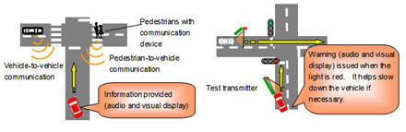
WHAT IS I.T.S?
The term intelligent transportation system (ITS) refers to efforts to add information and communications technology to transport infrastructure and vehicles in an effort to manage factors that typically are at odds with each other, such as vehicles, loads, and routes to improve safety and reduce vehicle wear, transportation times, and fuel consumption.

Slide 4
BASIC IDEA OF I.T.S
–Safety
–reliability
–efficiency
–quality of means of transport.

Slide 5
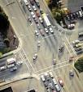
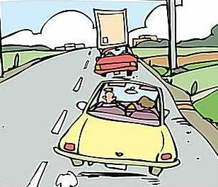

PROBLEMS IN TRANSPORTATION………….
TRAFFIC CONGESTION
FUEL CONSUMPTION
TO REDUCE ROAD
ACCIDENTS

Slide 6
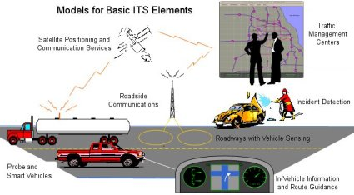
FEATURES OF THE INTELLIGENT TRANSPORATION SYSTEM

Slide 7
Intelligent transportation technologies
Wireless communications
Computational technologies
Sensing technologies
Video vehicle detection
Probe & smart vehicles
The incident detection centers
In vehicle information & route guide

Slide 8
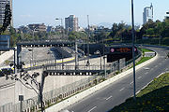
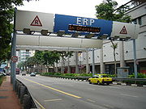
Intelligent transportation applications
Electronic toll collection
Electronic toll collection (ETC) makes it possible for vehicles to drive through toll gates at traffic speed, reducing congestion at toll plazas and automating toll collection.
Emergency vehicle notification systems
The in-vehicle e-Call is an emergency call generated either manually by the vehicle occupants or automatically via activation of in-vehicle sensors after an accident.

Slide 9
I.T.S REQUIREMENTS IN INDIA
Number of vehicles – Risen hence road accidents have also increased.
World’s highest annual road fatalities - 80,000 persons killed on Indian roads every year.
I.T.S India project –
To improve road safety and the efficiency of transportation systems.
Close cooperation between European and Indian stakeholders, defining key issues for ITS deployment in particular, Intelligent Integrated Safety Systems.

Slide 10
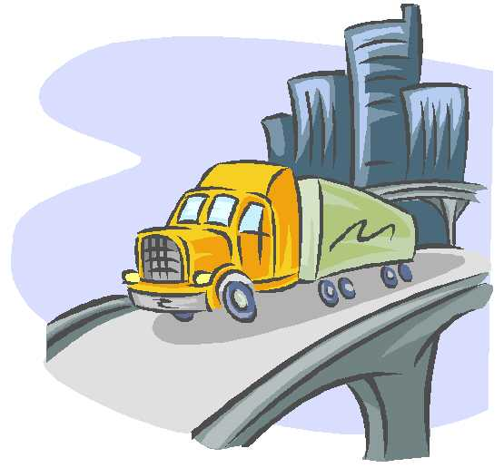
ROAD SAFETY IN INDIA
Ownership of cars in India - 6 per thousand of population as against 500 in developed economies.
Causes Of Road Accidents
➢ Driver’s fault -83.5%
➢ Pedestrian fault/fault of passengers -4.7%
➢ Mechanical defect in vehicles -3%
➢ Bad roads -1.1%
➢ Bad weather -0.9%
➢ Other factors-6.8%
eg cattle, fallen trees, road blockages, non-functioning of signals and
absence of rear reflectors/road signs

Slide 11
E-Safety IN INDIA
What is eSafety? Why is it required in India?
Car manufacturers
Transport service providers
eSafety
Telecom companies

Slide 12
EMERGENCY MANAGEMENT SYSTEMS
What is Emergency Management System?
Emergency Management has four phases:-
➢ Sense the type of emergency and the location
➢ Reach the victim with appropriate personnel and equipment, as required
➢ Care for the victim as appropriate
➢ Feedback to enable audit and healthy evolution of the system and its services.

Slide 13
TRAFFIC AND TRAVELLER INFORMATION
Variable/Changeable Message Signs -Travelers around the metropolitan cities are being assisted with Variable/Changeable Message Signs (VMS, CMS) and dynamic route guidance systems for travel conditions and directions.
G.I.S information system -The Bangalore Metropolitan Transport Corporation (BMTC) is one of the few public transport agencies using satellite navigation technology for fleet tracking and monitoring, and they want to upgrade their systems to provide real-time information to their passengers.

Slide 14
PUBLIC TRANSPORT
Improving the accessibility and attractiveness of public transport is a key factor to help reduce congestion in towns and cities.
Public transport management has the important task of coordinating the various forms of public transport to allow multi-modal travel.
Safety in Public Transport
Over the two decades 1975-95 the number of road accident fatalities increased in India by 282% and injuries by 220%. Data for 1995 shows that buses and Heavy Goods Vehicles were involved in 35% of accidents (TERI Report).

Slide 15
CONCLUSION
Road safety has become a pressing issue in India.
The number of deaths has reached upto 80,0000
The rapid increase in eSafety is in growing demand to the day.
The making of new vehicles should be well equipped with necessary technologies.
To change the road user culture. This includes stronger levels of traffic regulation and enforcement.

Slide 16
Thanks

